Slide 1
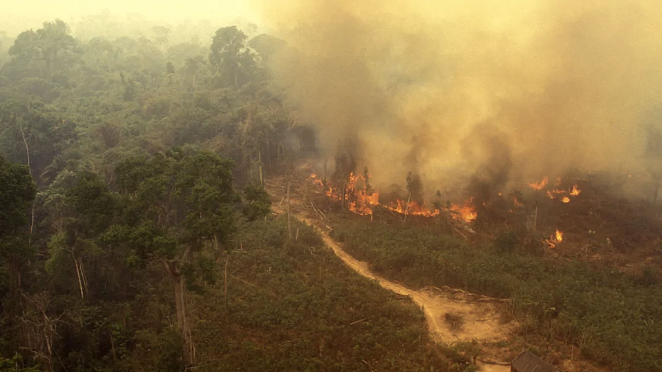
Class 12 Human Impacts on Biogeochemical Cycles
Larry Swatuk
lswatuk@mta.ca

Slide 2
Test on Friday during class time
Covers first 8 classes
True/False; Multiple Choice; Fill in the Blank
50 questions; 50 minutes; 50 marks
The quiz assesses: conceptual understanding of EIA, perspectives on nature, power and governance, socio-ecological systems, thermodynamics, and ecosystem-based management.
Relevant slides and corresponding narrative posted on Moodle under Week 8.

Slide 3
What matters about matter: There is no “away”
97% of organic mass is composed of six nutrients
C – carbon
H – hydrogen
N – nitrogen
O – oxygen
P – phosporus
S – sulphur
These nutrients are cycled continuously among different components of the ecosphere in characteristic paths known as biogeochemical cycles

Slide 4
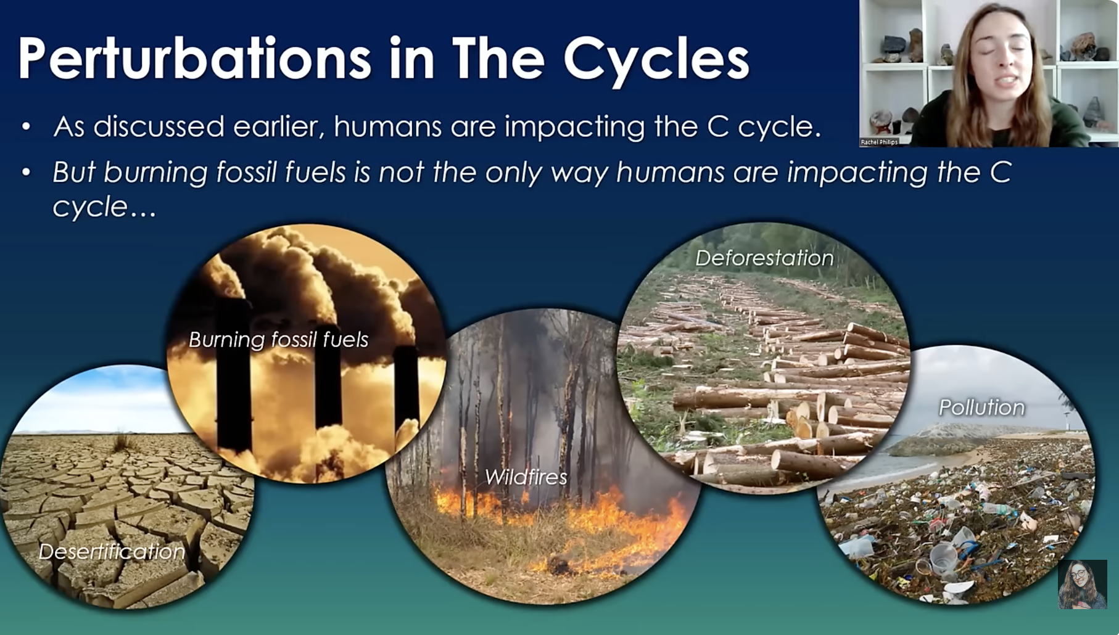

Slide 5
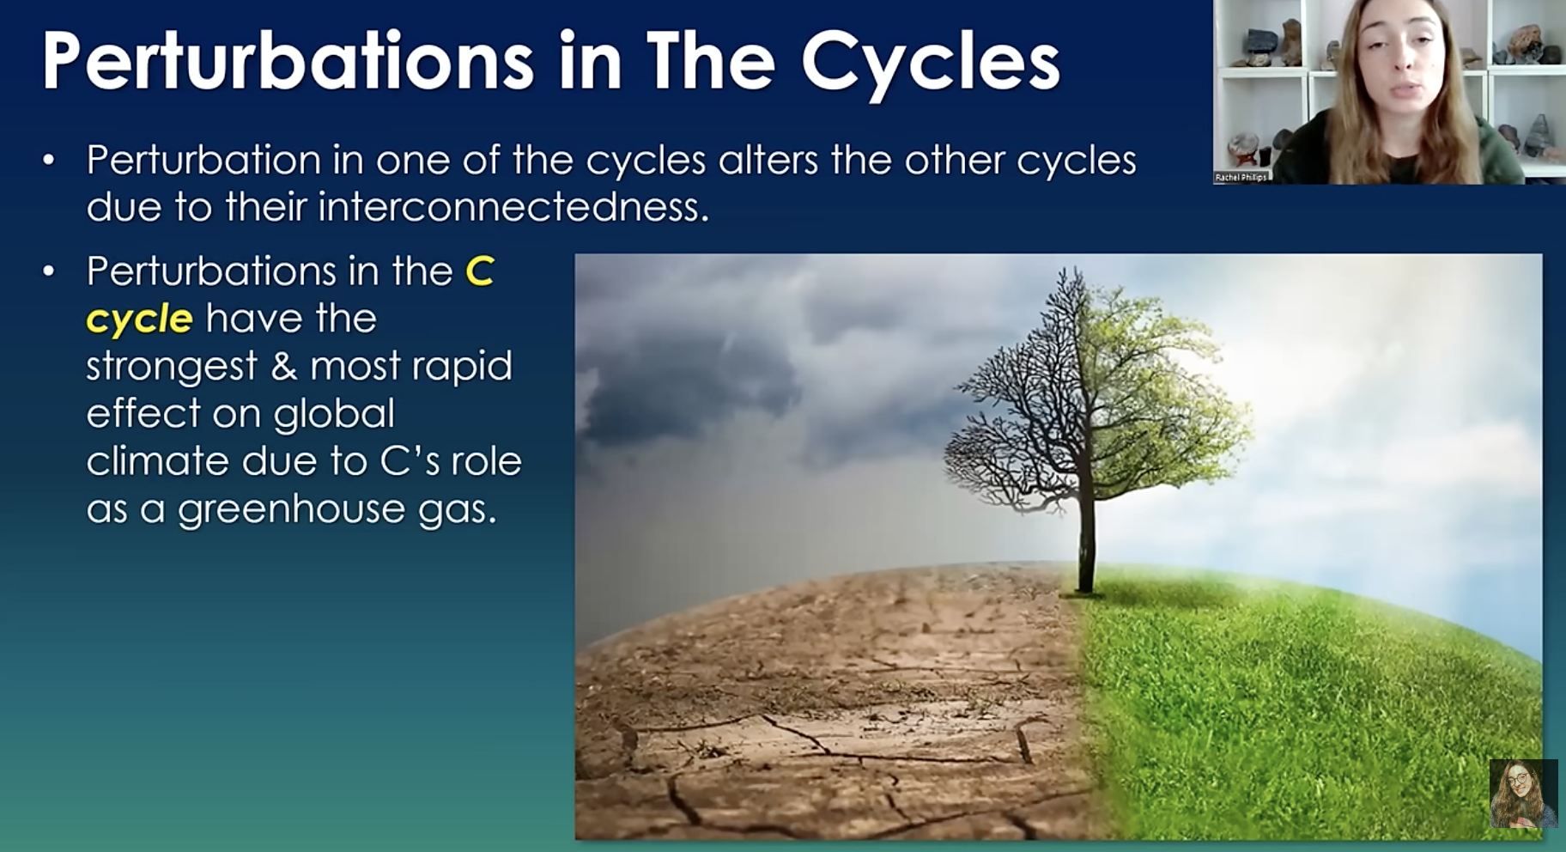

Slide 6
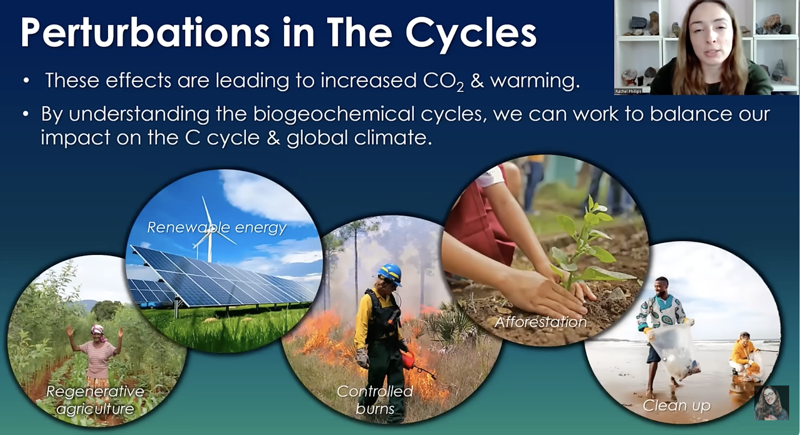

Slide 7
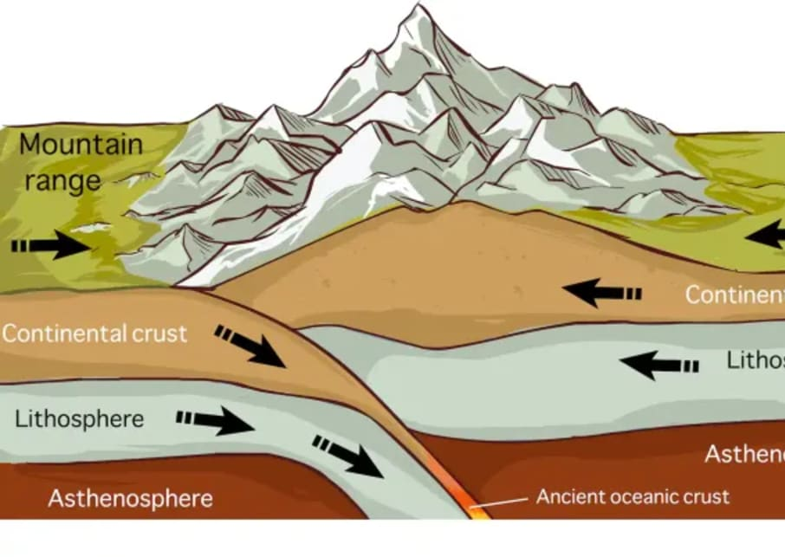
Earth Systems are Dynamic but Slow
Humans have accelerated slow, geologically regulated cycles (C, P, S) and amplified biologically mediated cycles (N, H₂O), pushing them beyond ecological thresholds. Rebalancing efforts increasingly focus on slowing flows, closing loops, and restoring system feedbacks rather than simply treating symptoms.

Slide 8
The Carbon Cycle
Major Human Impacts
Fossil fuel combustion → rapid transfer of geologic carbon to the atmosphere (CO₂).
Deforestation and land-use change→ loss of carbon sinks and release of stored biomass carbon.
Industrial processes (e.g. cement production) → direct CO₂ emissions from calcination*.

Slide 9
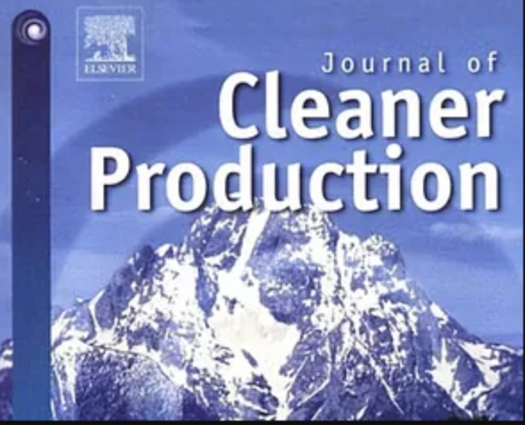
The Carbon Cycle
Rebalancing Efforts
Decarbonization: renewable energy, electrification, energy efficiency
Carbon sequestration: reforestation, afforestation, soil carbon storage
Carbon capture and storage (CCS) and negative-emissions technologies
Carbon pricing, emissions trading, net-zero policies

Slide 10
Interrelationship of Dominant Actors: aka the ‘social relations of production’
State (.gov)
Laws, Policies, Regulations, Inducements
Civil
Society
(.org)
Private
Sector
(.com)
Pressure to ‘do the
right thing’
Lobbying, self-
regulating,

Slide 11
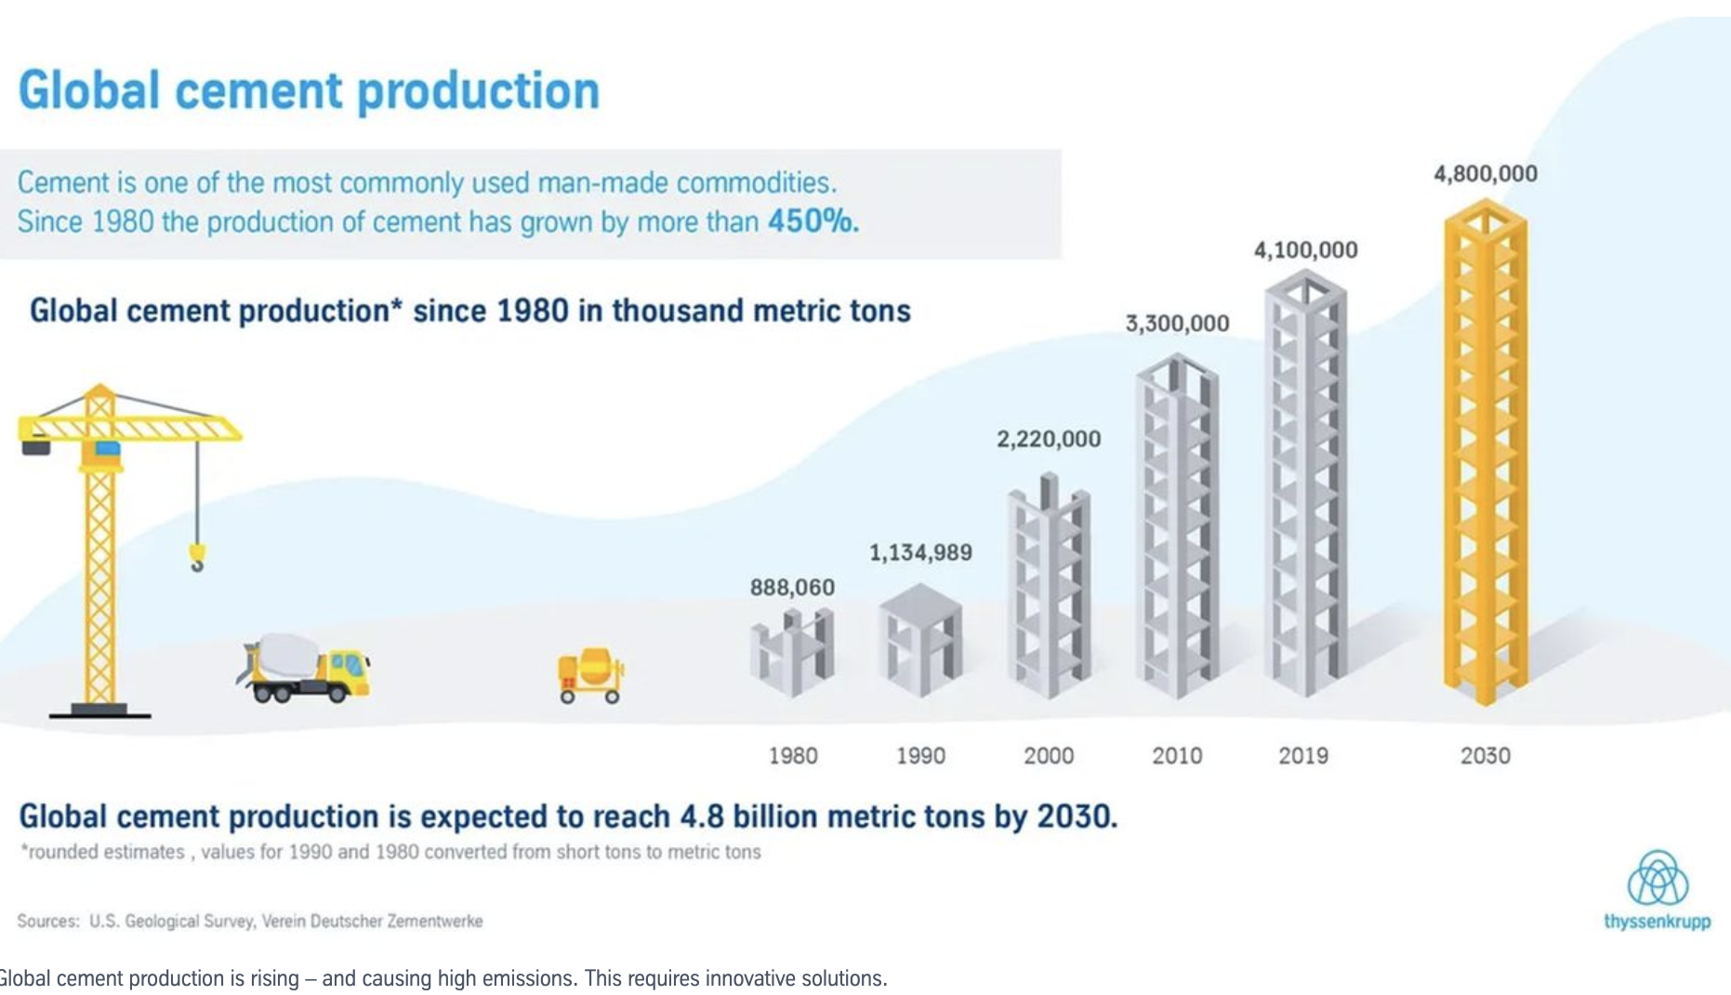

Slide 12
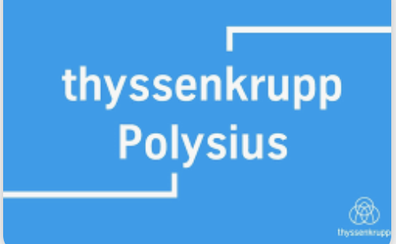
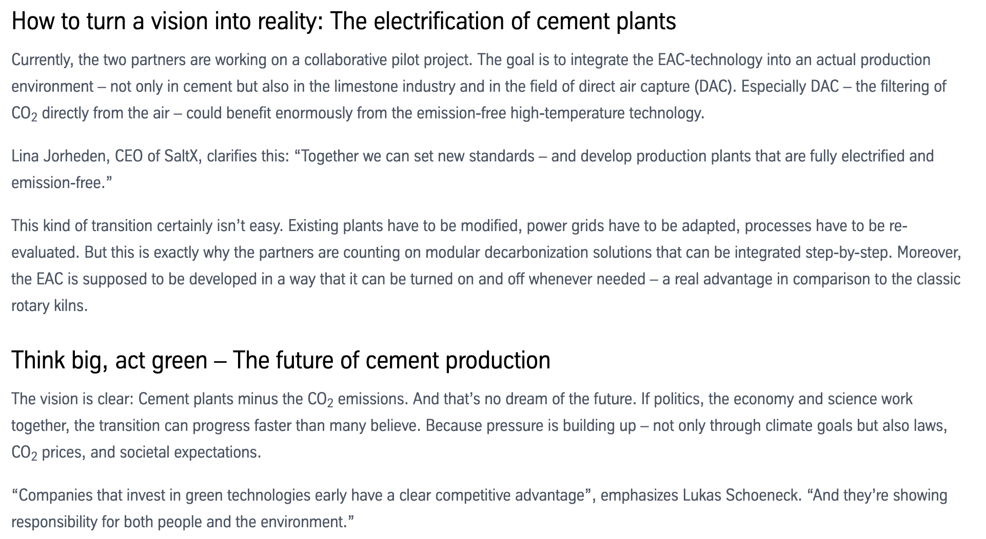


Slide 13



